Slide 1


AD-HOC INSIGHTS
CONSUMER GOODS

Slide 2
AGENDA
Background/Context
Getting Familiar with ATLIQ TECHNOLOGY and their markets,products.
Famiiriaze yourself with the given input data.
AD-HOC requests with sql query solutions and visualization in the form of charts.

Slide 3
BACKGROUND/CONTEXT
THE COMPANY-Atliq hardware is a largest computer hardware producing company across globe.
BACKGROUND: The company seeks to gain deeper insights to facilitate the expansion of its consumer goods business.
PROBLEM:We are given 10 ad-hoc requests norder to provide insights.
APPROACH:The company aims to derive more profound insights through SQL queries to strategically expand its consumer goods business.

Slide 4
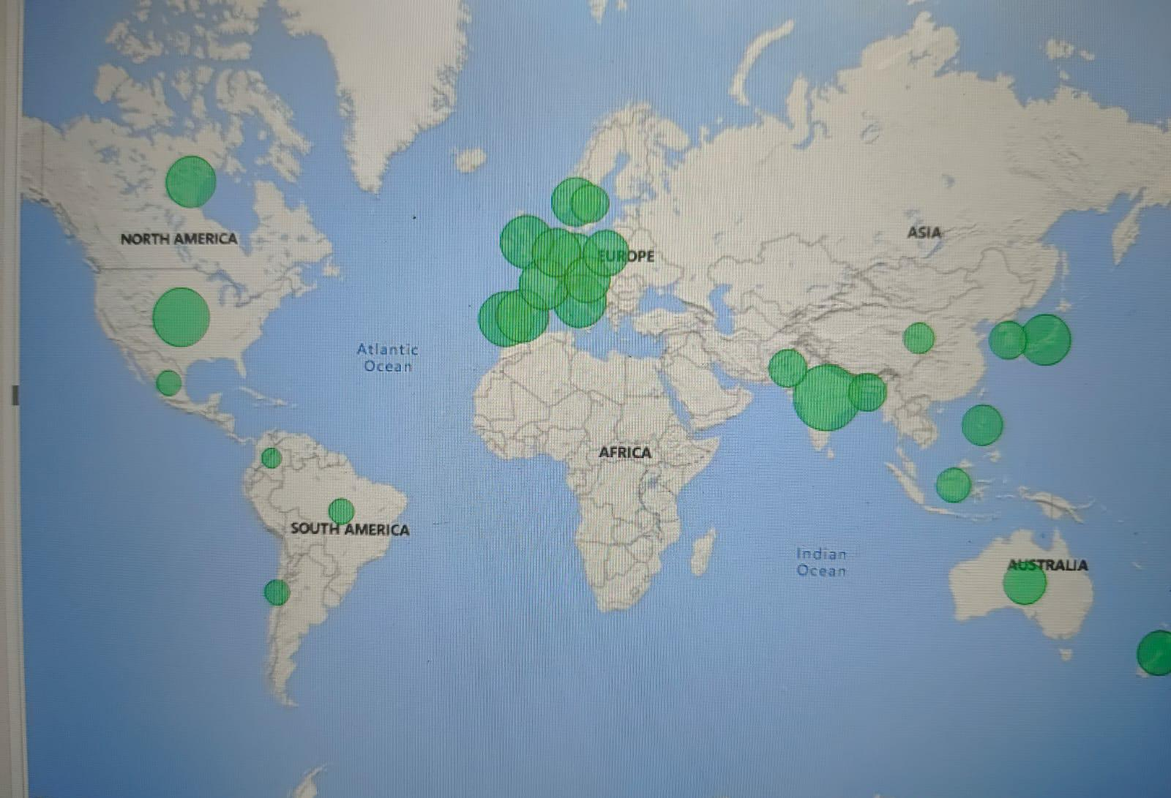
Markets

Slide 5
DATA GIVEN
The data given to us are in the csv format. There are 2 dimension tables and 4 fact tables’
DIMENSION TABLES
Dim_customer
Dim_product
FACT TABLES
Fact_gross_price
Fact_sales_monthly
Fact_pre_invoice_deductions
Fact_manufacturing_cost

Slide 6
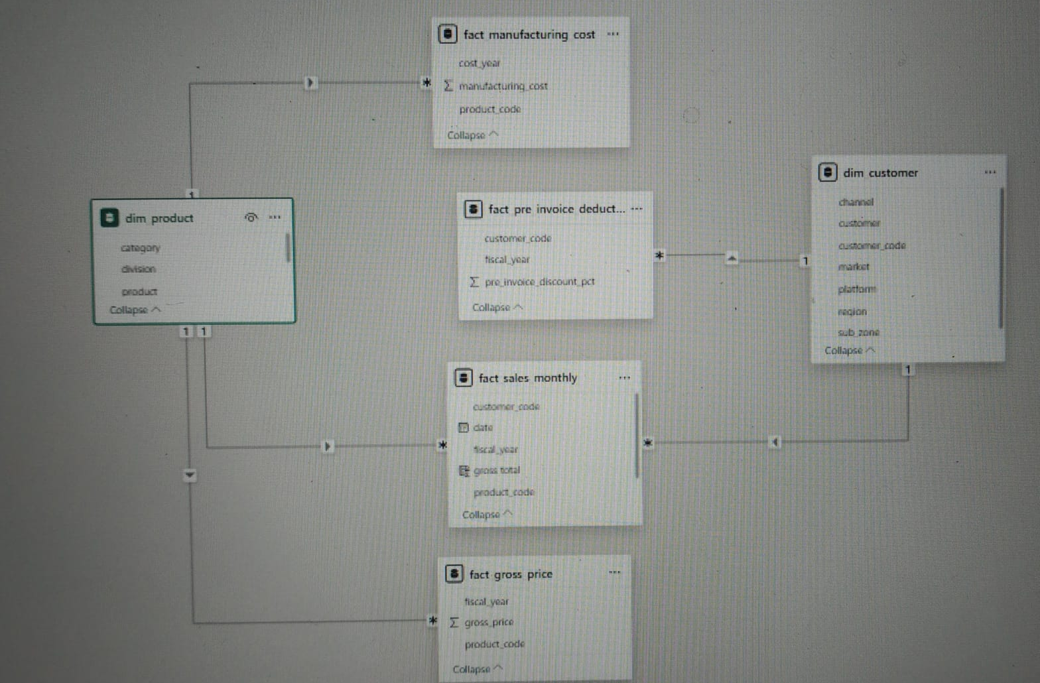
DATA MODELLING

Slide 7
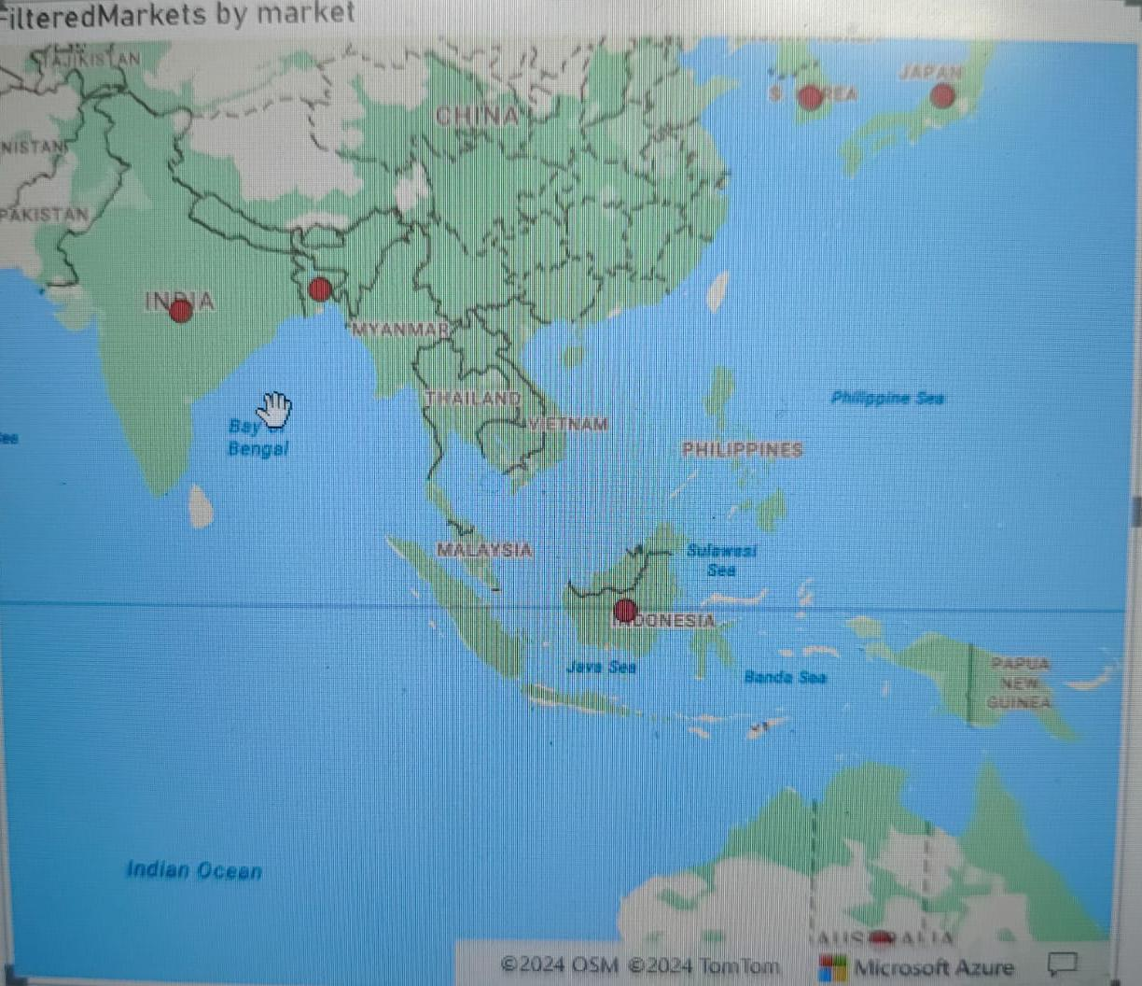
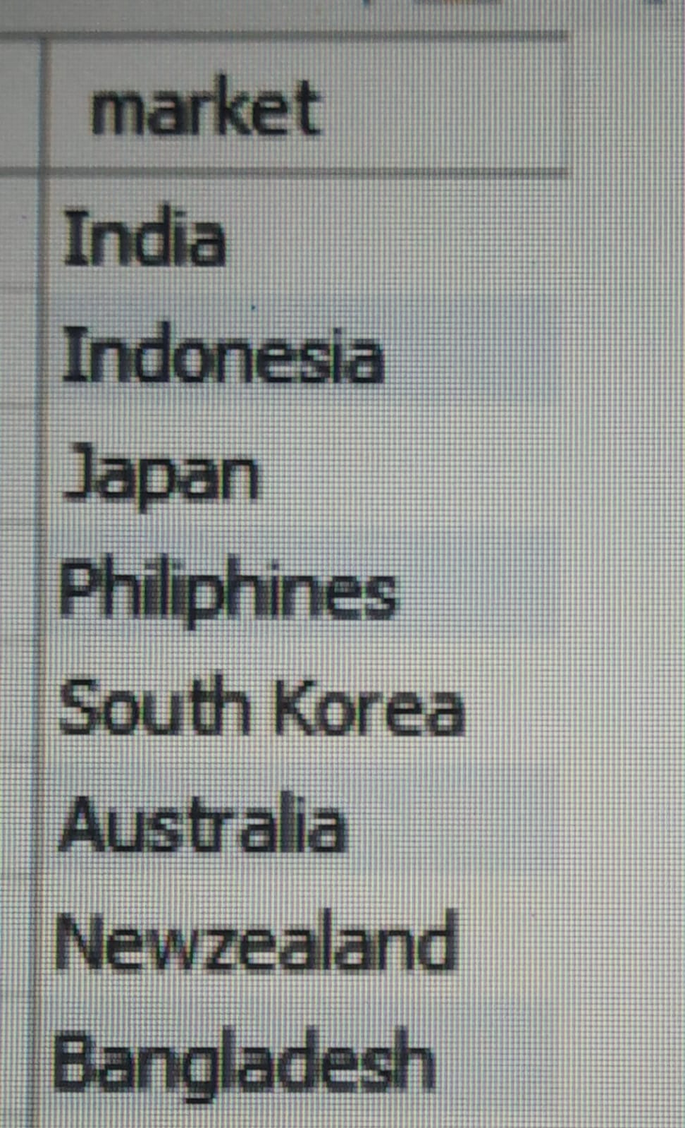
REQUEST 1 Provide the list of markets in which customer "Atliq Exclusive" operates its business in the APAC region.

Slide 8
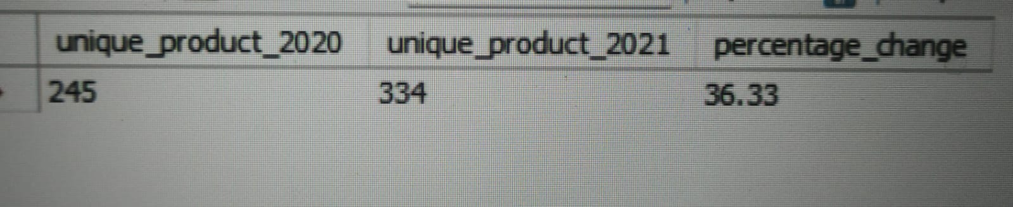
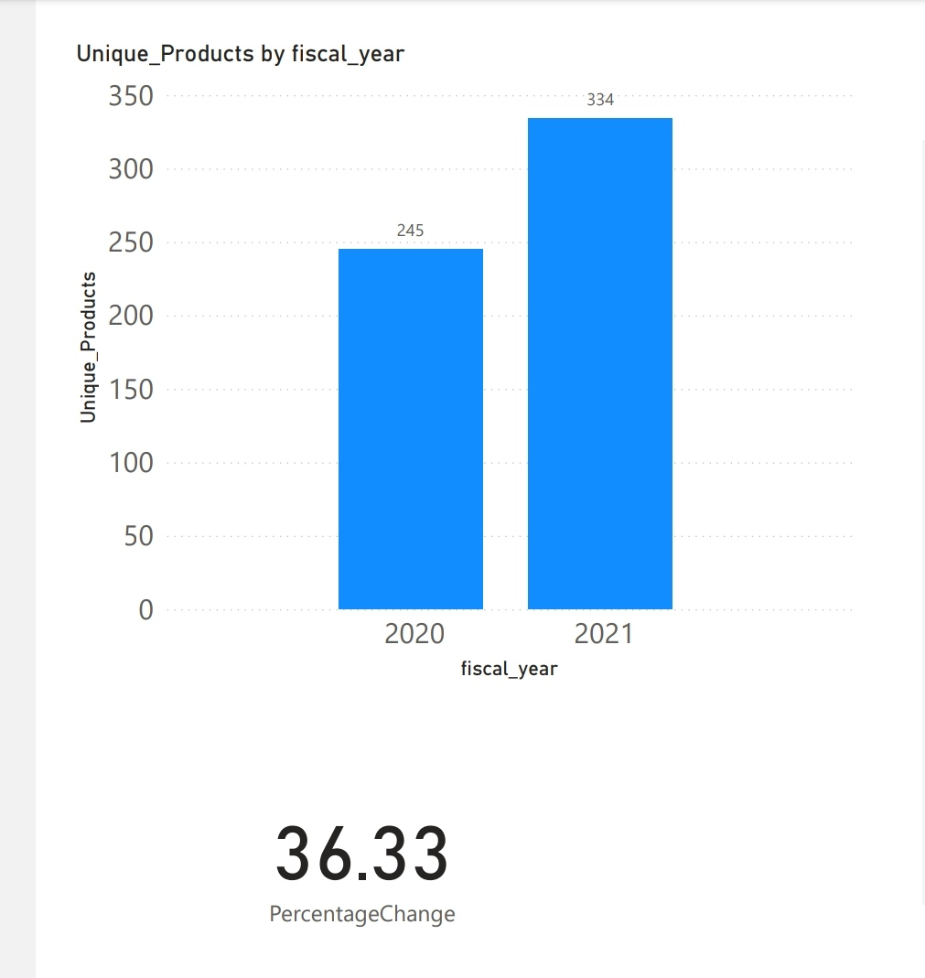
REQUEST 2 What is the percentage of unique product increase in 2021 vs. 2020? The final output contains these fields, unique_products_2020 unique_products_2021 percentage_chg

Slide 9
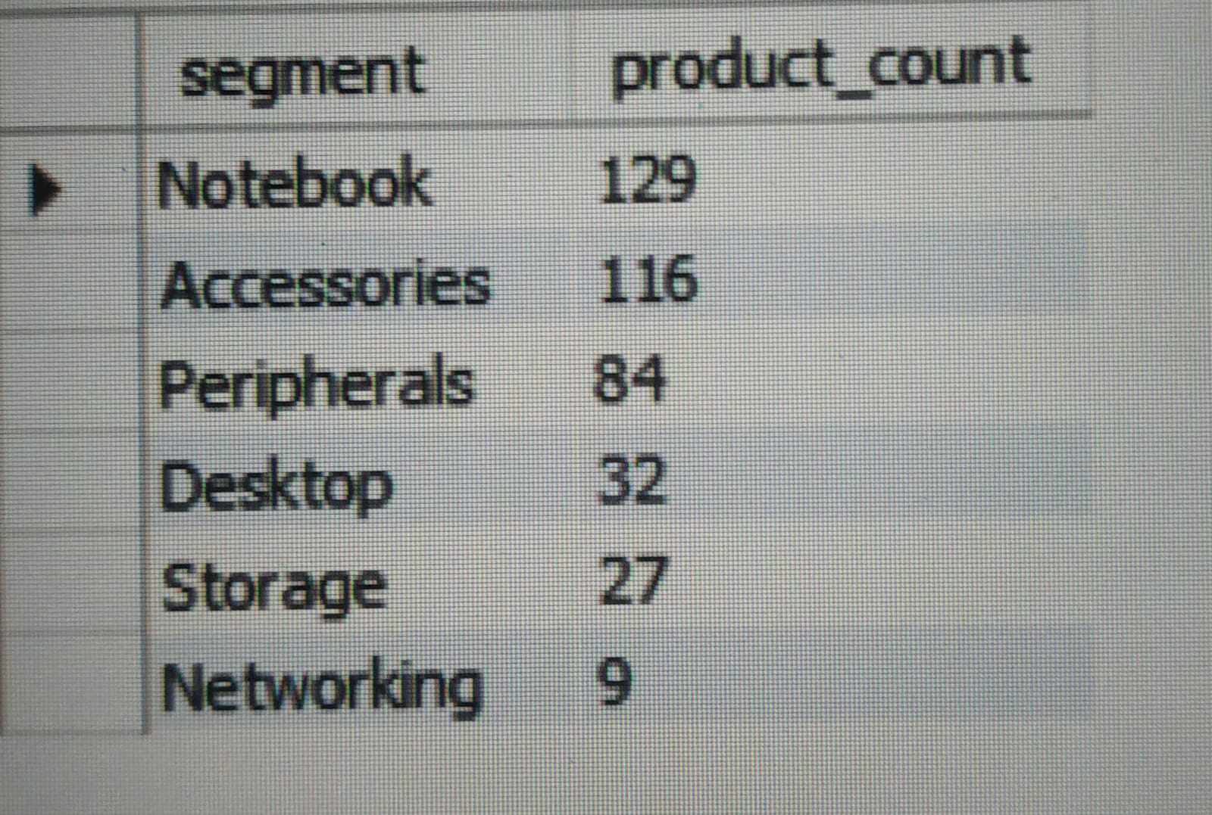
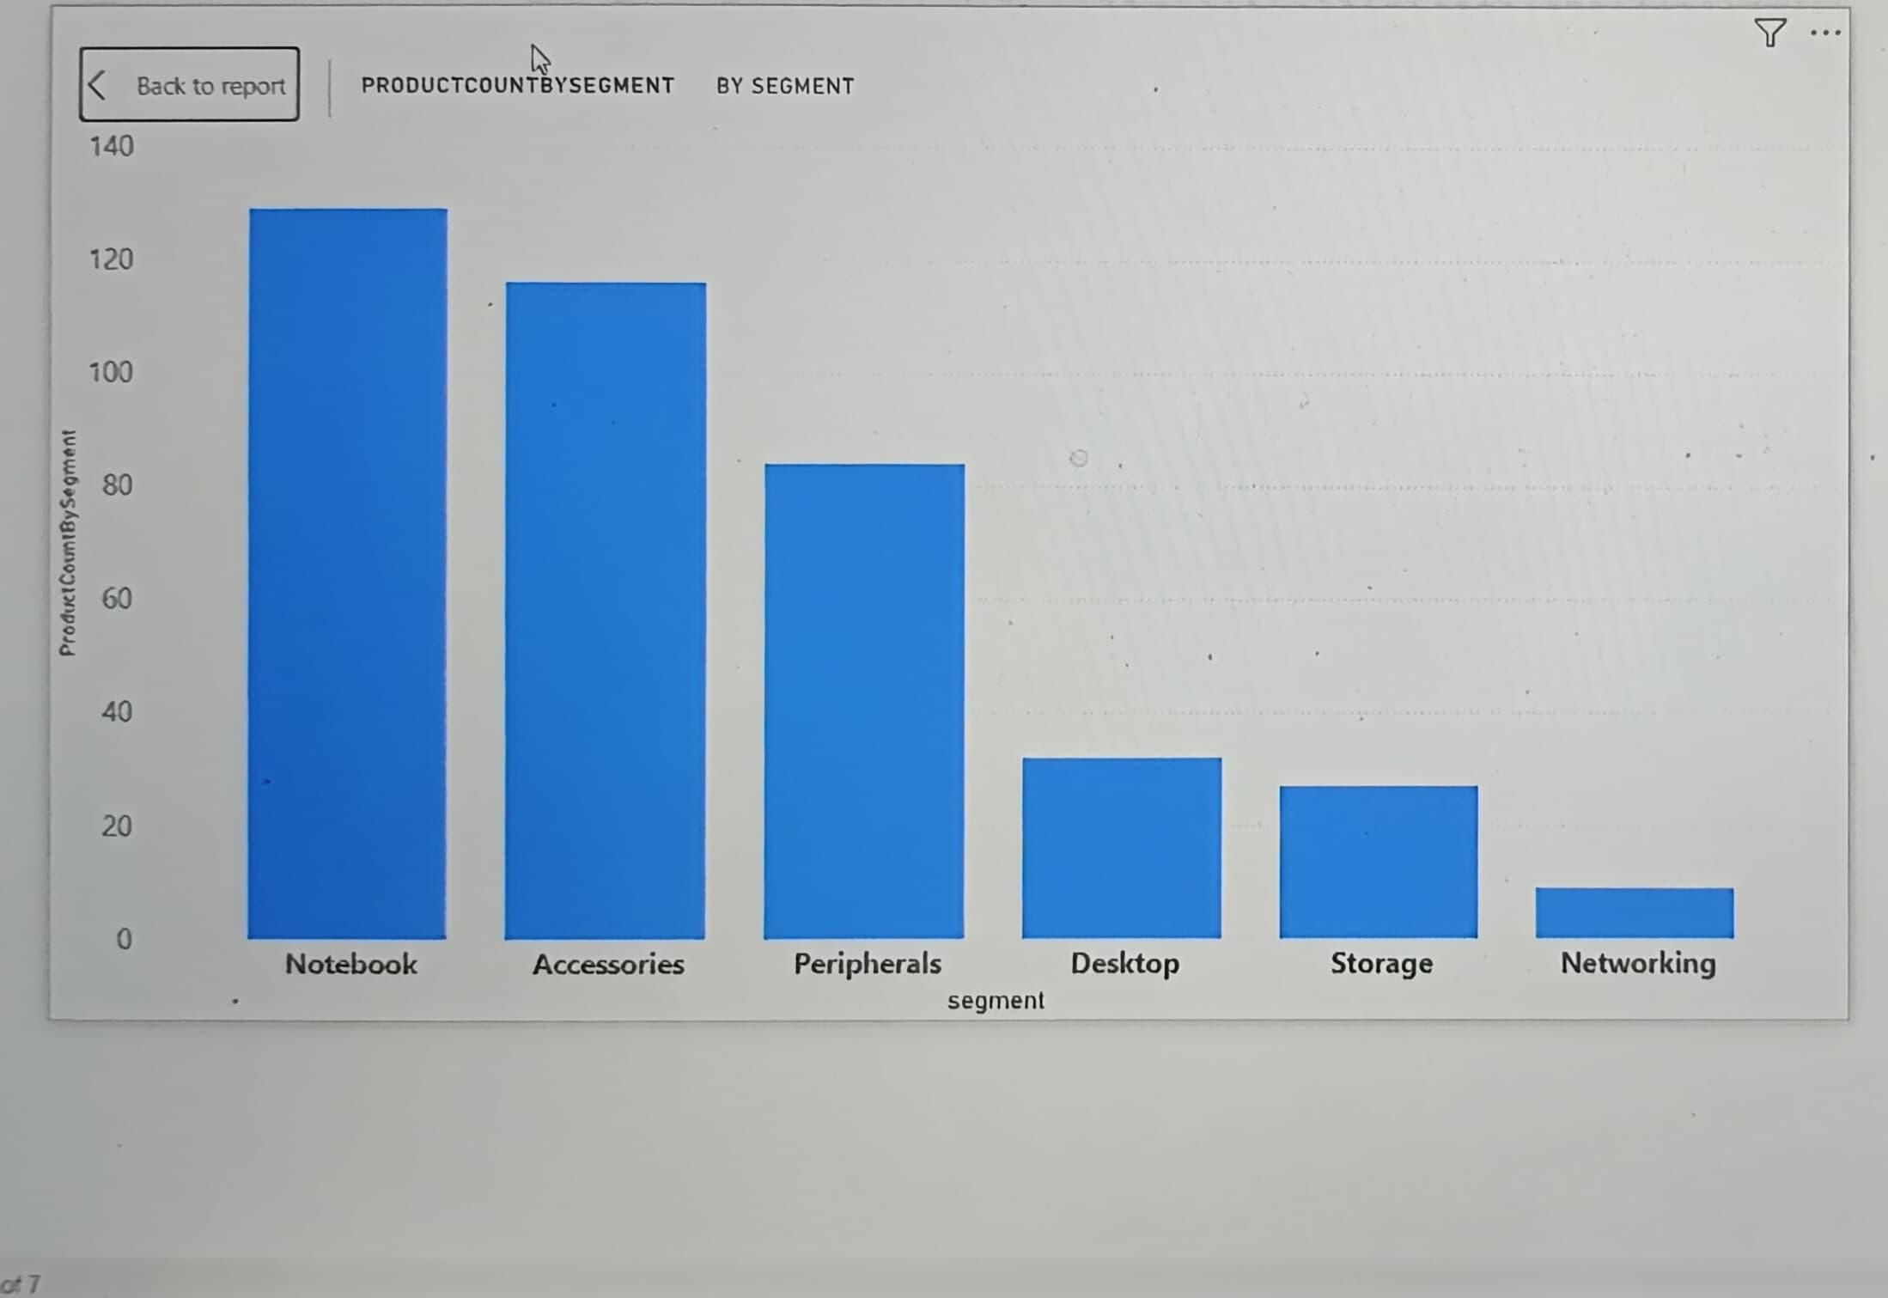
REQUEST 3 Provide a report with all the unique product counts for each segment and sort them in descending order of product counts. The final output contains 2 fields, segment product_count
The top 3 segments have really higher average greater than 100
and rest 3 have the least not even greater than 30.

Slide 10
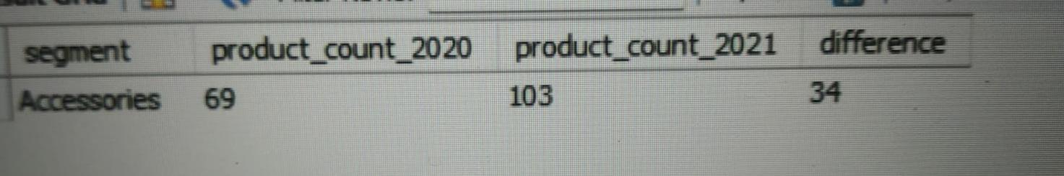
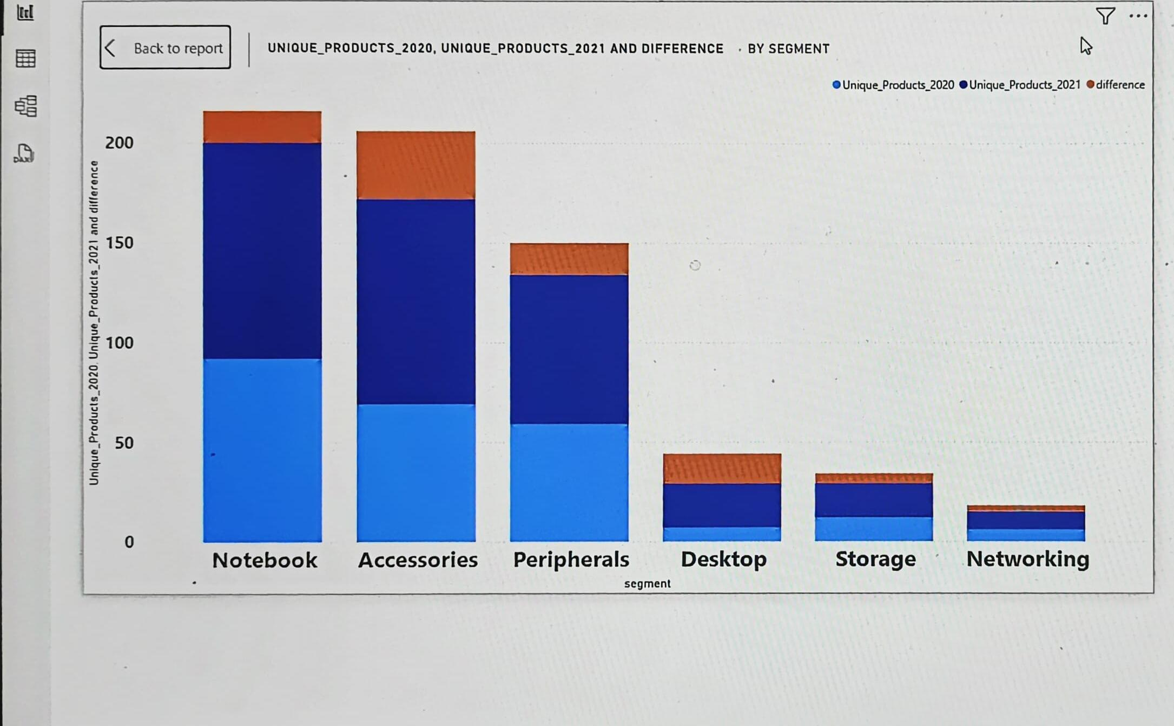
REQUEST 4 Follow-up: Which segment had the most increase in unique products in 2021 vs 2020? The final output contains these fields, segment product_count_2020 product_count_2021 difference

Slide 11
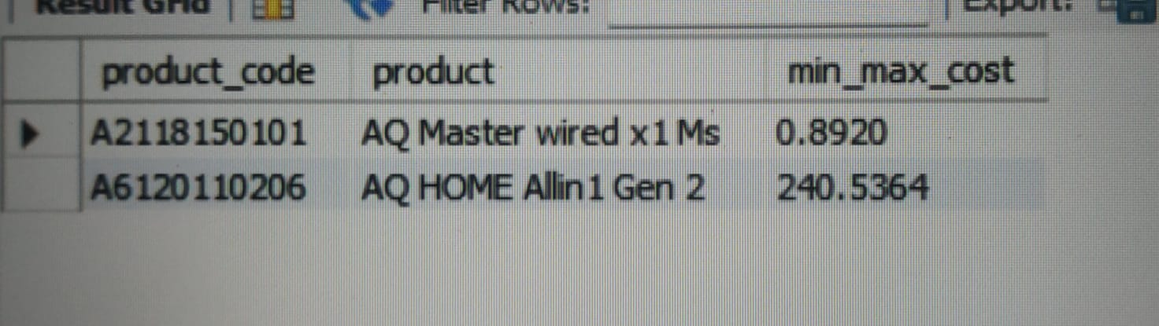


REQUEST 5 Get the products that have the highest and lowest manufacturing costs. The final output should contain these fields, product_code product manufacturing_cos
AQ Master wired x1Ms
AQ aHome Allin1gen2

Slide 12
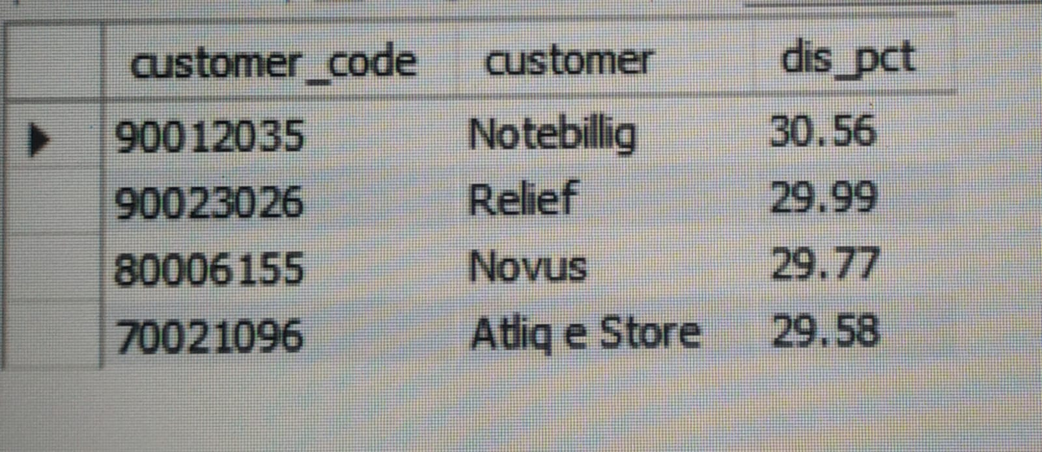
REQUEST 6 Generate a report which contains the top 5 customers who received an average high pre_invoice_discount_pct for the fiscal year 2021 and in the Indian market. The final output contains these fields, customer_code customer average_discount_percentage

Slide 13
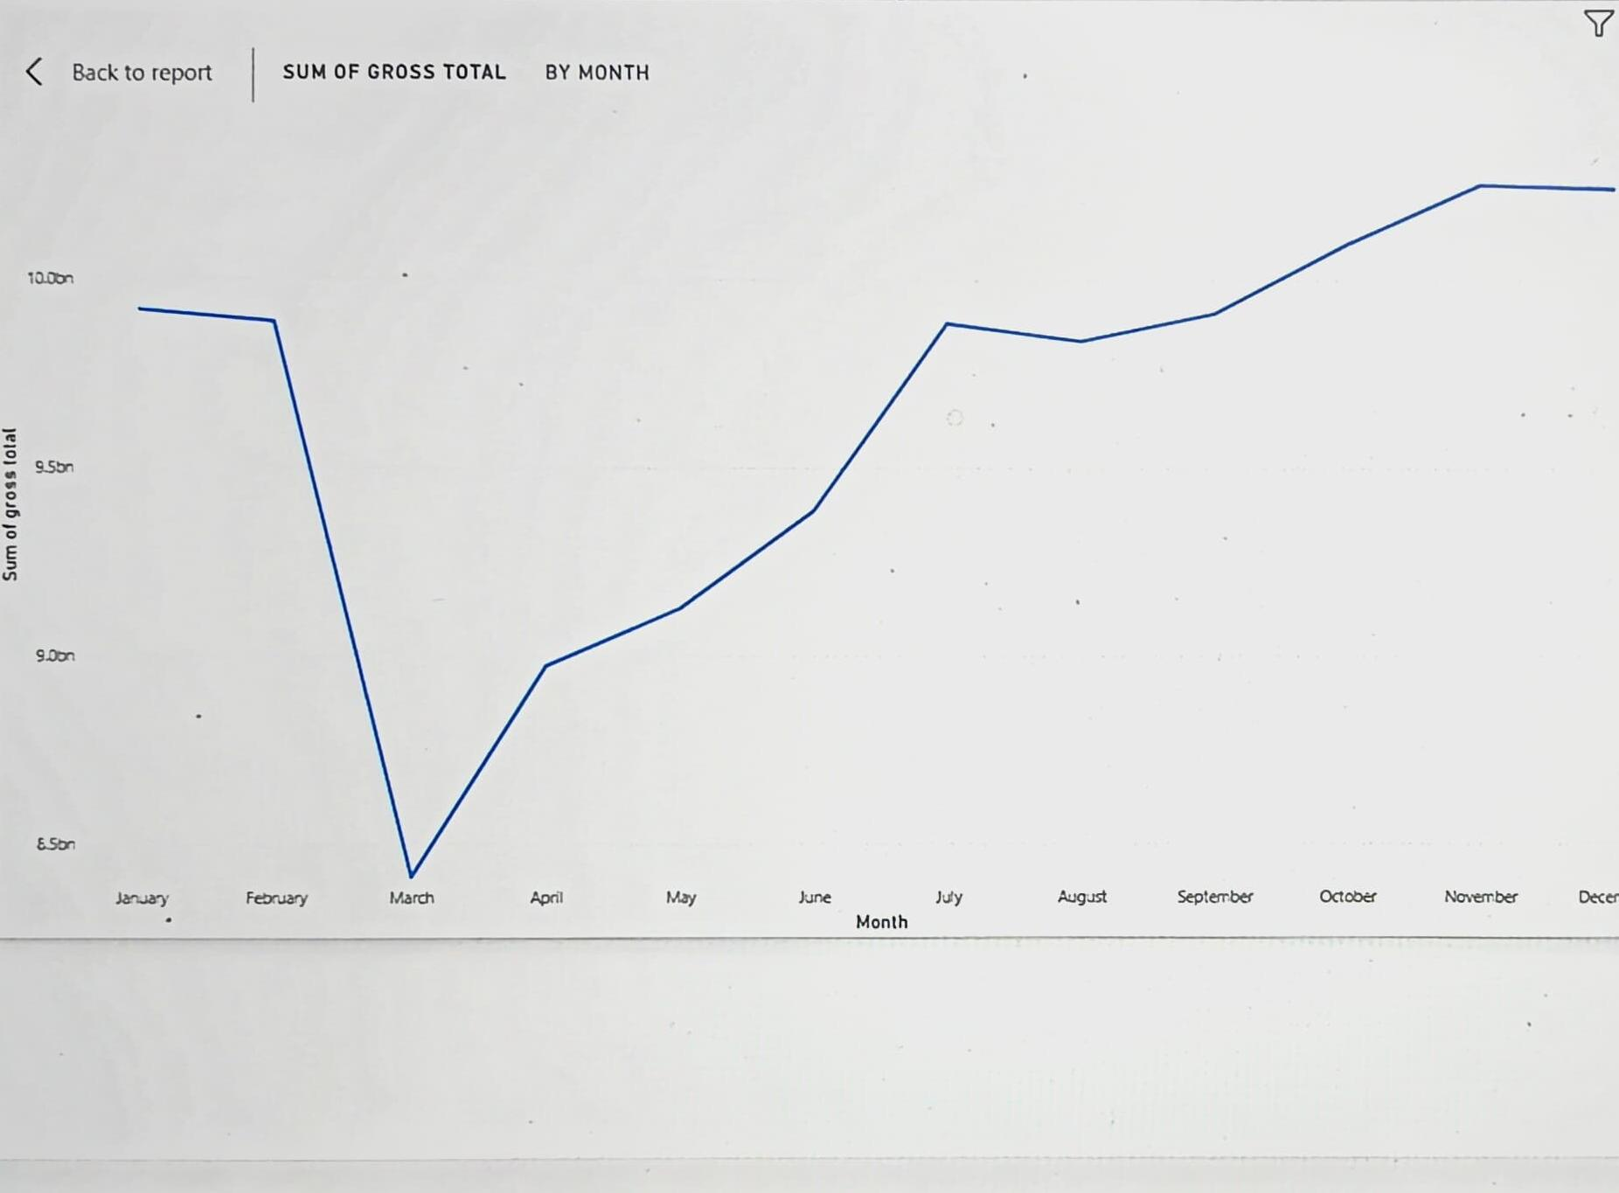
Request 7 Get the complete report of the Gross sales amount for the customer “Atliq Exclusive” for each month. This analysis helps to get an idea of low and high-performing months and take strategic decisions. The final report contains these columns: Month Year Gross sales Amount

Slide 14
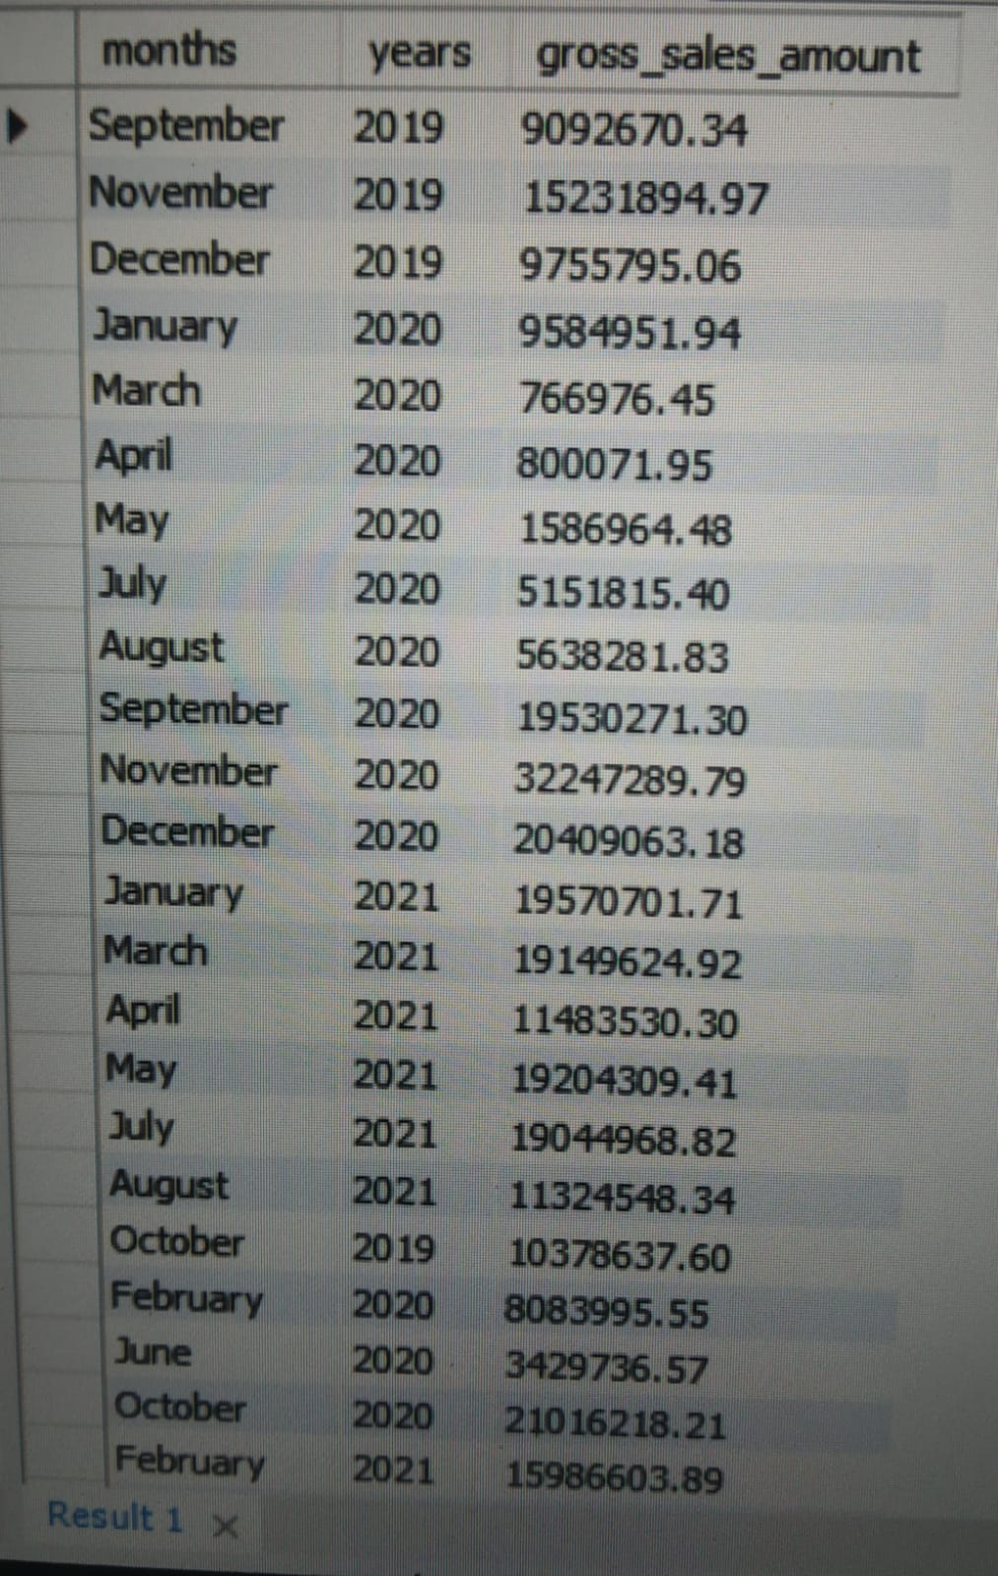

Slide 15
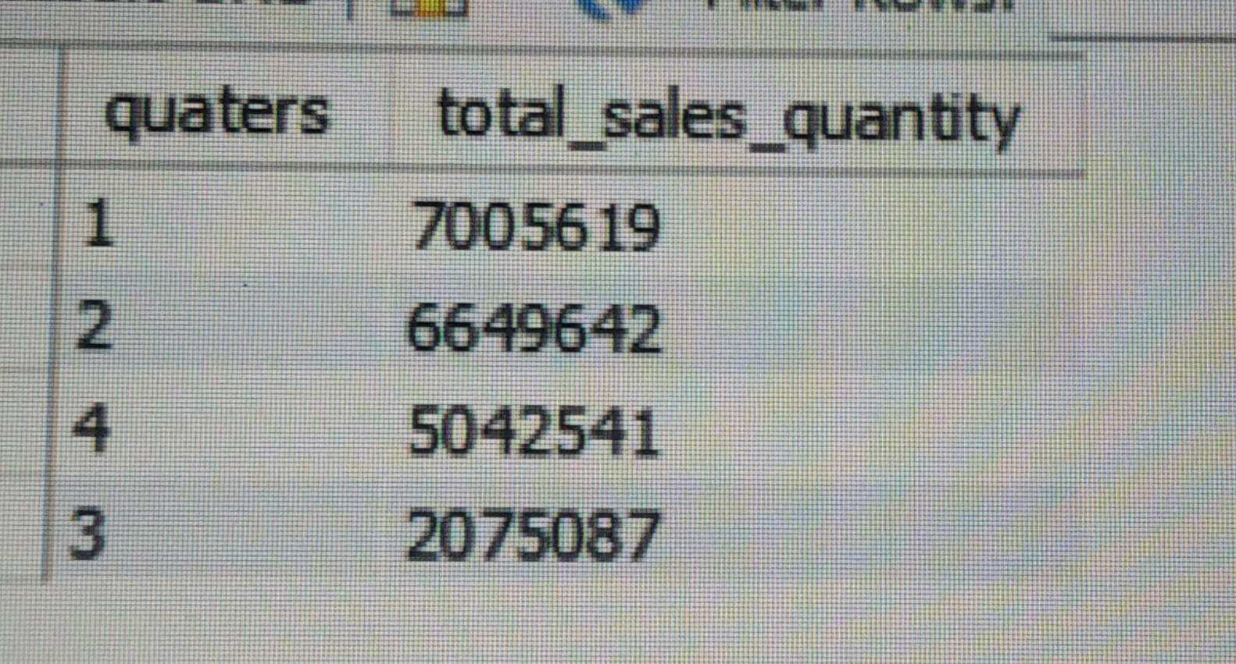
REQUEST 8 In which quarter of 2020, got the maximum total_sold_quantity? The final output contains these fields sorted by the total_sold_quantity, Quarter total_sold_quantity

Slide 16
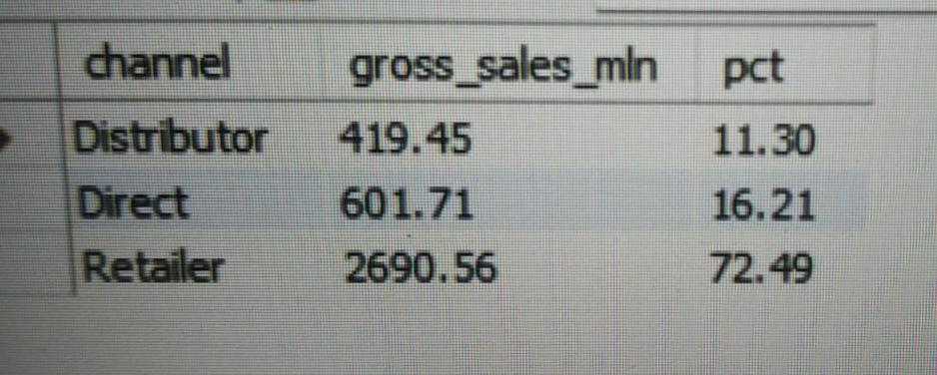
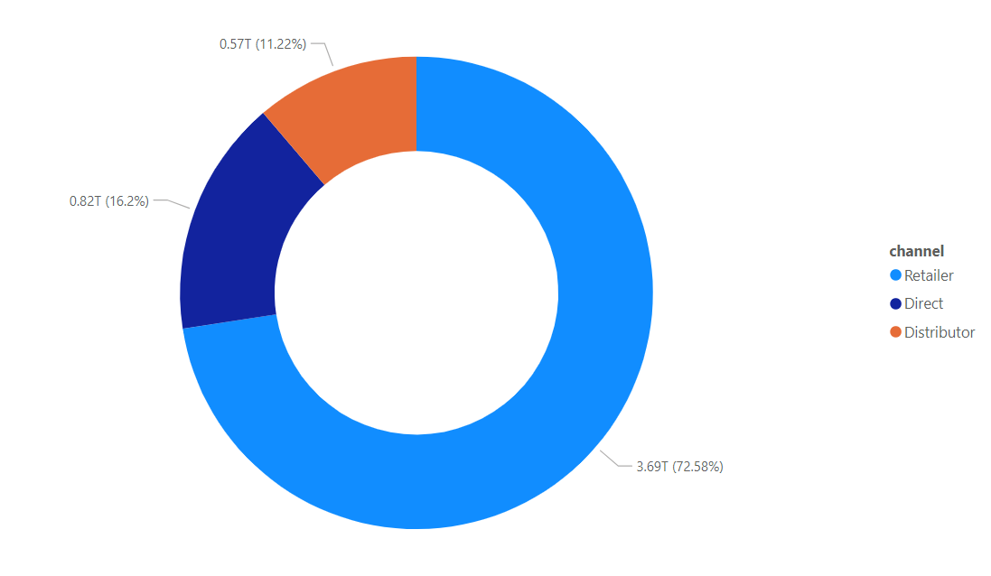
REQUEST 9 Which channel helped to bring more gross sales in the fiscal year 2021 and the percentage of contribution? The final output contains these fields, channel gross_sales_mln percentage

Slide 17
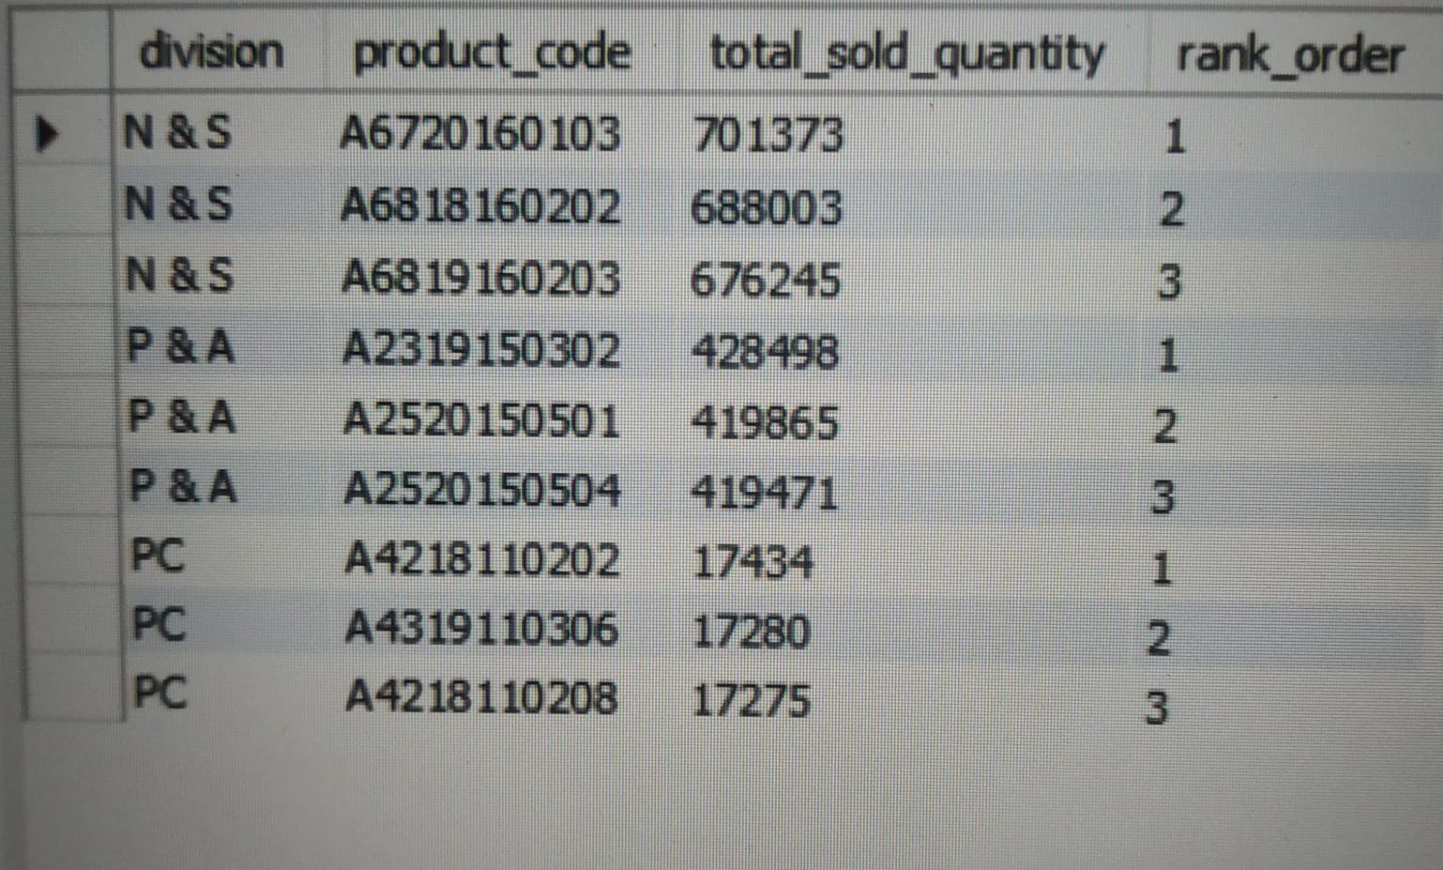
REQUEST 10 Get the Top 3 products in each division that have a high total_sold_quantity in the fiscal_year 2021? The final output contains these fields, division product_code

Slide 18
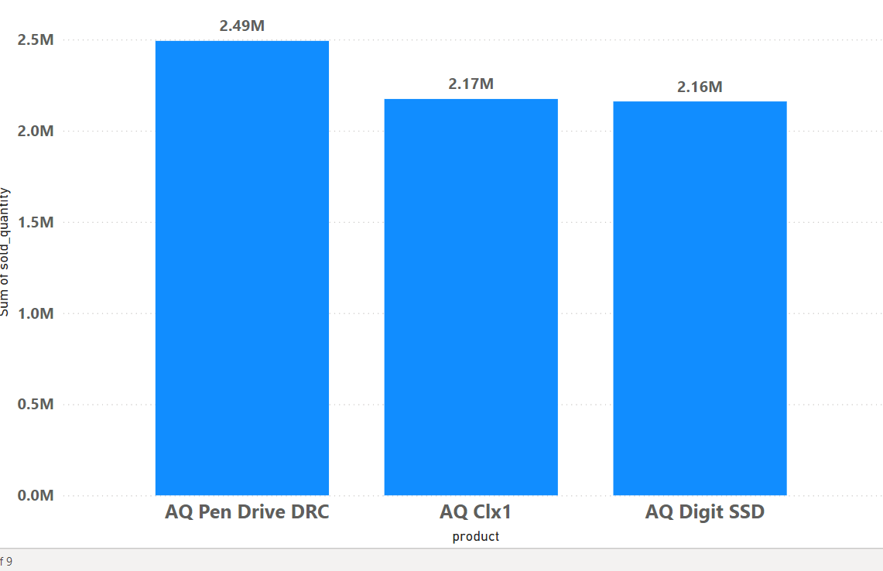
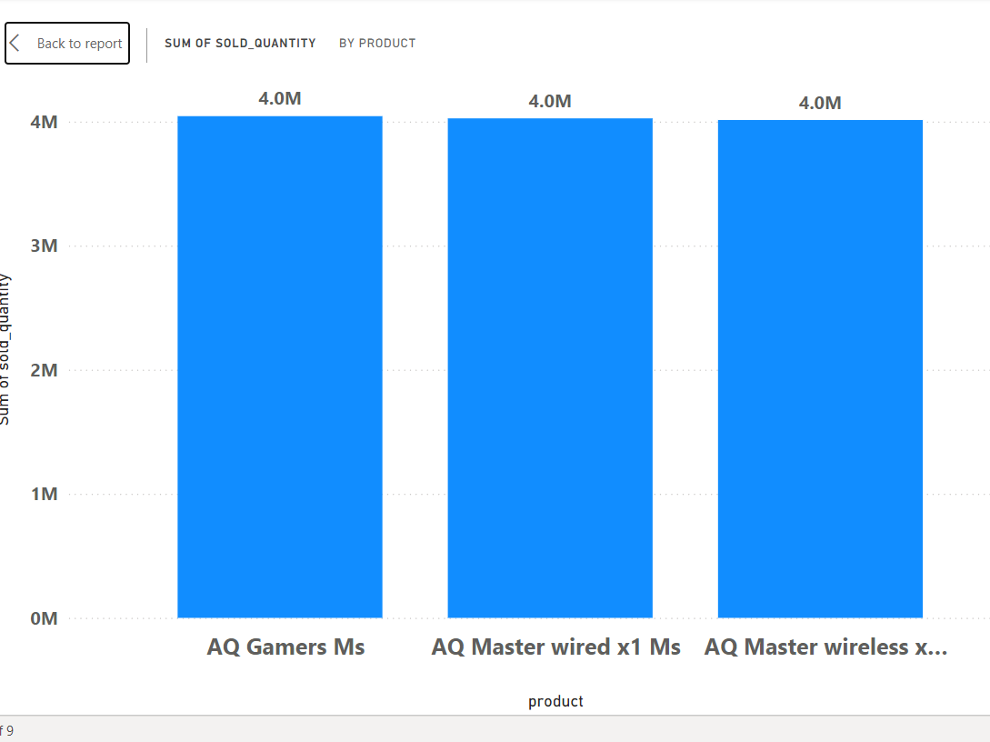
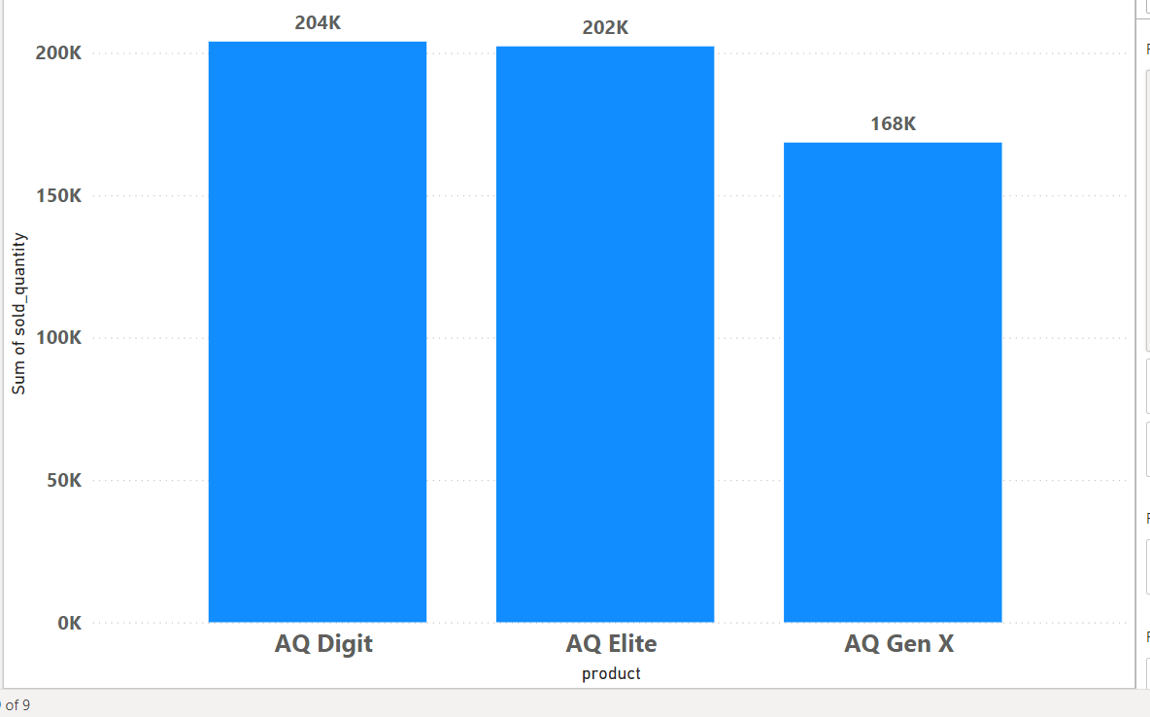
N & S
P&A
PC

